Slide 1
Version 2.0 12/28/25

Slide 2
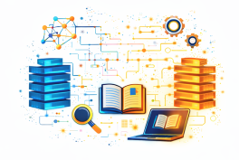


Understanding and Using RAG
Making LLMs Smarter by pairing your data with Gen AI
Presented by Brent Laster &
Tech Skills Transformations LLC
© 2026 Brent C. Laster & Tech Skills Transformations LLC
All rights reserved

Slide 3
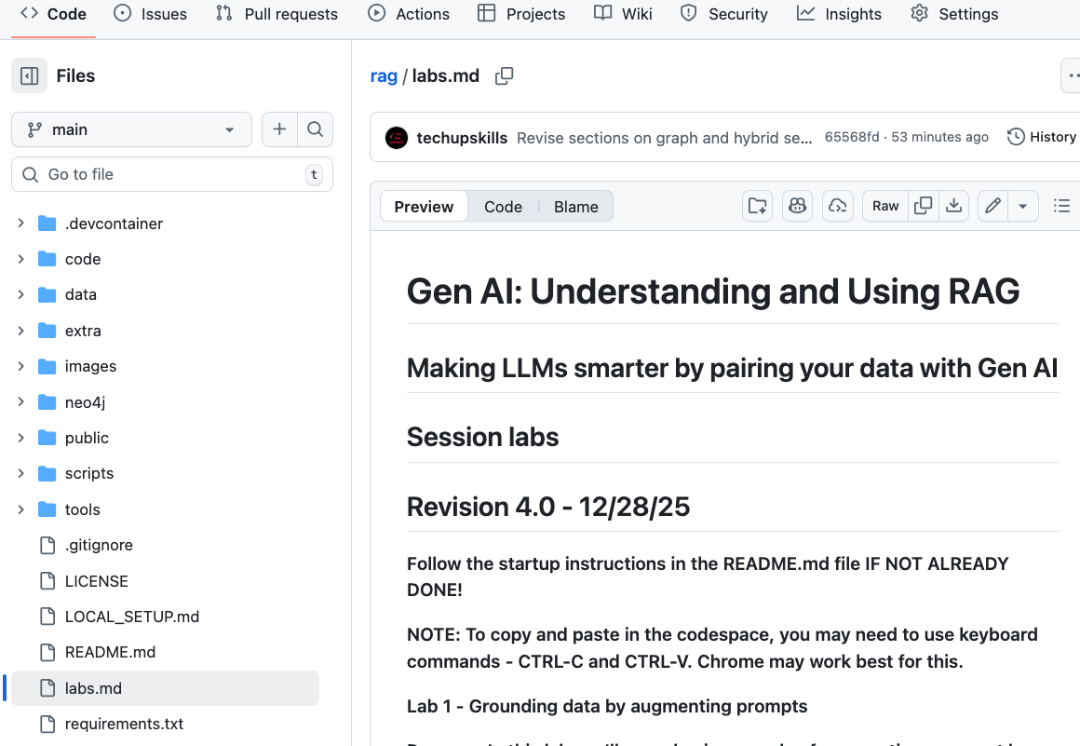
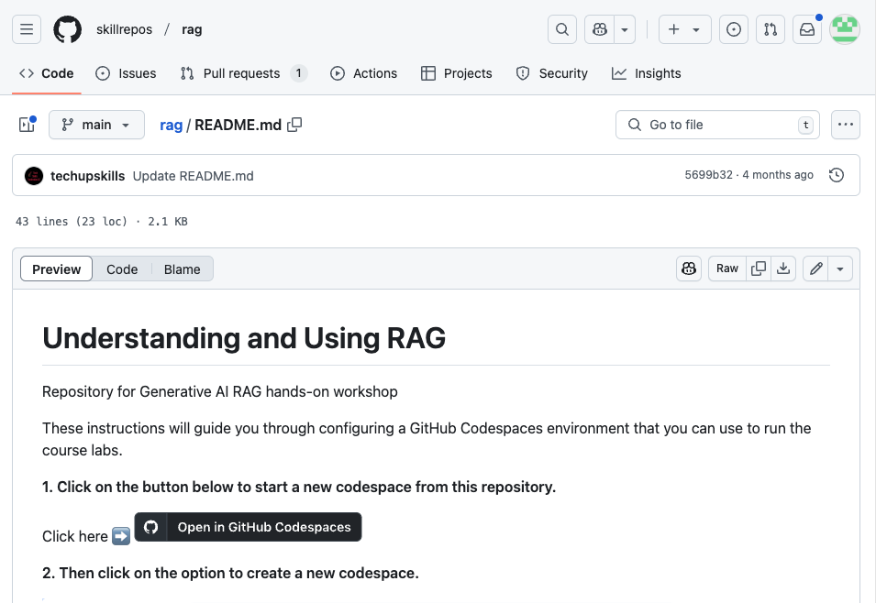
Lab prep - repo is github.com/skillrepos/rag
Go to https://github.com/skillrepos/rag ( Chrome may work best for copy and paste actions.)
Follow instructions in README.md
Startup codespace with quickstart button in README . (This will take a while to run!)
Open labs.md in codespace -or- in web

Slide 4


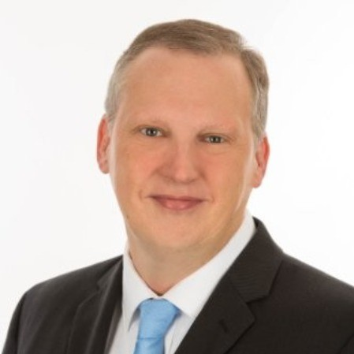
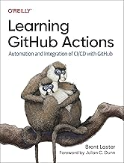
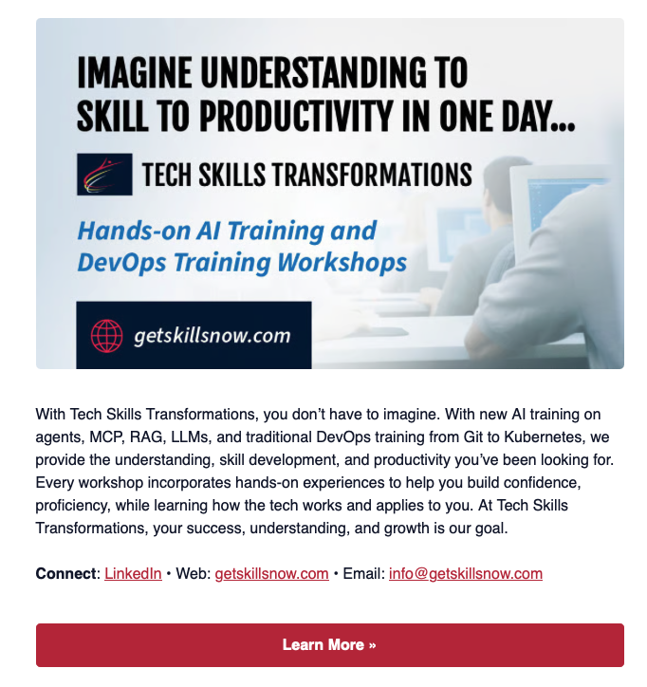
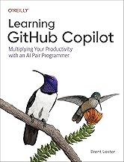

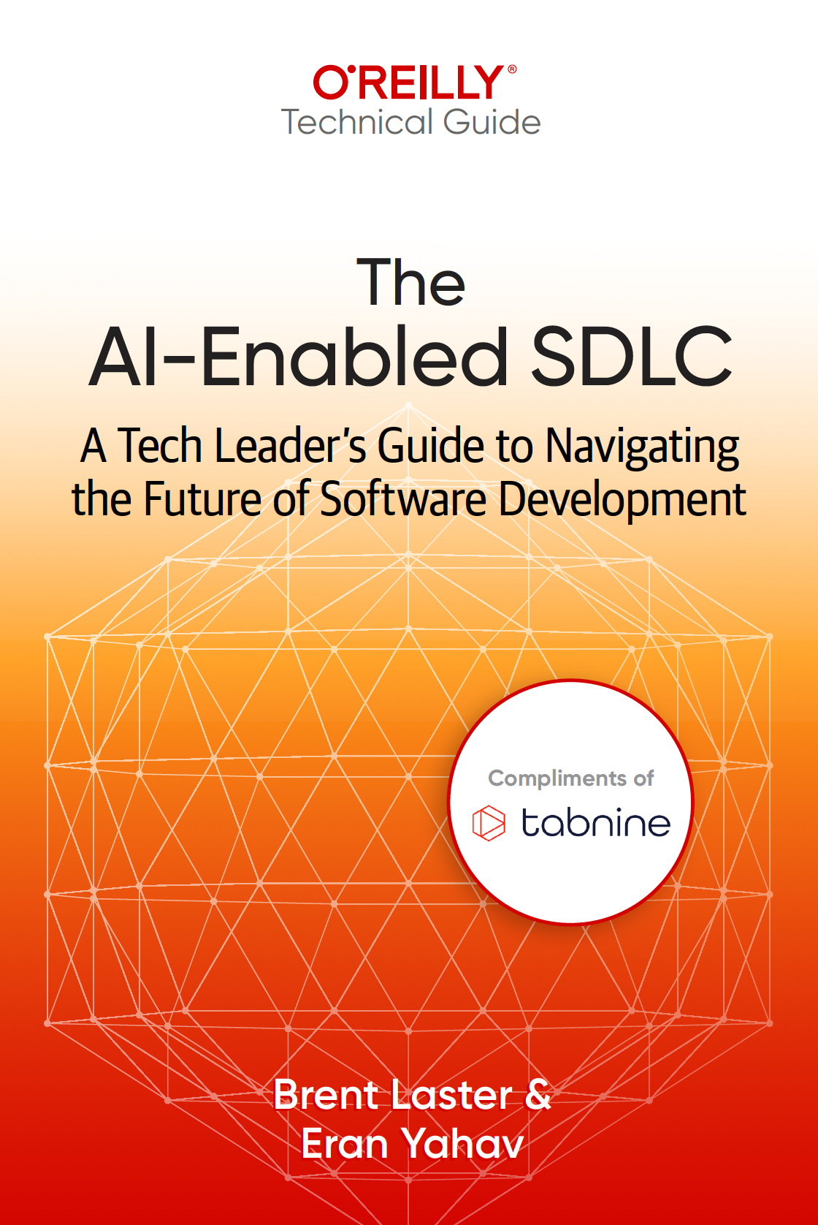

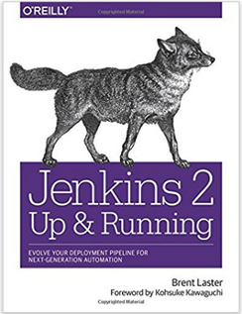



About me
Long career in corporate:
Principal Dev
Manager/Senior Manager
Director
Founder, Tech Skills Transformations LLC
https://getskillsnow.com
info@getskillsnow.com
LinkedIn: brentlaster
X: @BrentCLaster
Bluesky: brentclaster.bsky.social
GitHub: brentlaster

Slide 5
Logistics
90-Minutes Training
30-Minutes Break
90-Minutes Training
Hands-on labs with time to complete each lab

Slide 6
Agenda - what we'll cover
What is RAG?
How does RAG work?
Ollama
Data stores for RAG
Embeddings and Vectors
Vector databases
Chunking
Data ingestion pipeline
Parsing data for RAG
Full RAG implementations
Prompting Templates
Knowledge Graphs
Graph RAG
Neo4j and Cypher
Data stores for RAG
Frameworks for implementing RAG
Hybrid RAG

Slide 7
Introduction to RAG

Slide 8

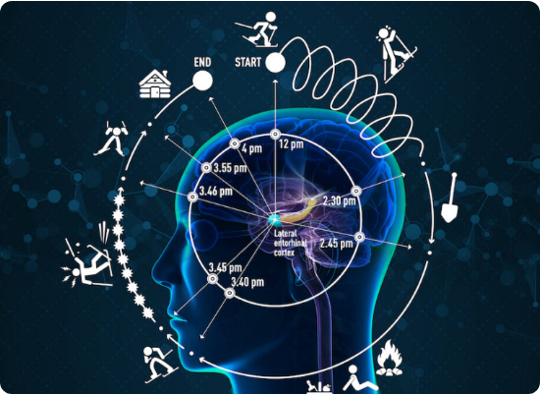
The Knowledge Problem
What LLMs Don't Know
Knowledge Cutoff: Training stopped at a specific date in the past.
Proprietary Data: Private company manuals or internal documents.
Real-time Events: News or data updates happening right now.
Specific Procedures: Unique internal troubleshooting guides.

Slide 9


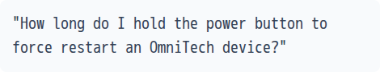
The Problem Illustrated
User Prompt
Standard LLM Response
"Typically 5-10 seconds for most electronic devices, though it varies by manufacturer..."
Generic Guess
The LLM has never seen OmniTech's internal manual, so it relies on generic probabilities.

Slide 10
Possible Solutions
Approach | Pros | Cons
Fine-tuning | Permanent knowledge absorption | Expensive, slow, requires deep expertise
Retraining | Full structural integration | Extreme cost, impractical for dynamic data
RAG | Fast, cheap, dynamic | Requires a separate retrieval system
Winner: RAG – Update knowledge in milliseconds, not months.

Slide 11
What is RAG?
Retrieve + Augment + Generate

Slide 12


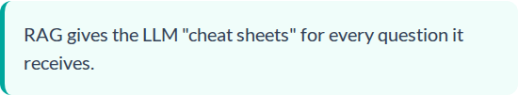
An "Open-Book Exam"
Memorization vs. Reference
Without RAG: Like taking a test from memory. You can only answer based on what you studied months ago.
With RAG: You get to bring your notes to the exam. You look up specific facts when needed and combine them with your existing knowledge.

Slide 13






How RAG Works Step-by-Step
1. Retrieve
2. Augment
3. Generate
Search your documents for content related to the user's question.
Add that found information into the prompt as "Context".
The LLM reads the context and answers based on facts, not guesses.

Slide 14
Before vs. After RAG
Feature | Without RAG | With RAG
Knowledge | Training data only | Training + YOUR data
Accuracy | Generic / Hallucination risk | Specific / Grounded in facts
Prompt | Question only | Context + Question
Source | Unknown origin | Traceable to docs

Slide 15

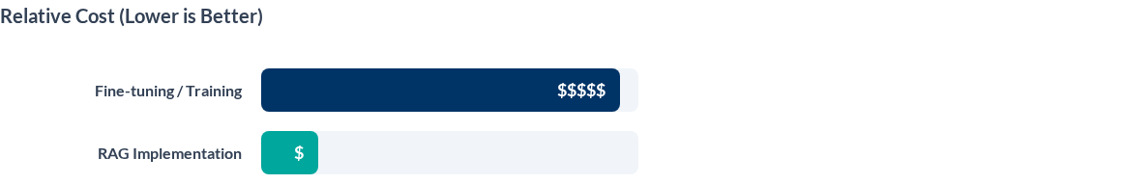
RAG vs. Training: Economics
Training is slow and static. If your data changes, you must pay to retrain.
RAG is instant and dynamic. Change the document in your folder, and the AI is updated immediately.

Slide 16
The RAG Mindset
"
Don't change the model. Change what you GIVE the model.
"
RAG works with any LLM, updates instantly, and grounds AI in your traceable data.

Slide 17
Working with Local LLMs

Slide 18
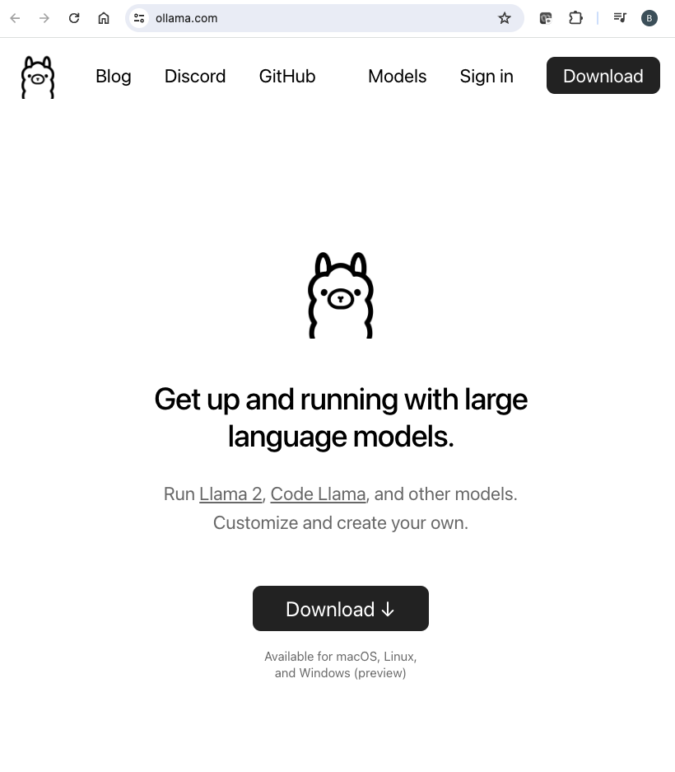
Ollama
Command line tool for downloading, exploring and using LLMs on local machine
open source
supports most of Hugging Face's popular models
allows uploading new ones
Links:
main site: https://ollama.com
GitHub: https://github.com/ollama/
Advantages
speeds up and simplifies
model selection and download
configuring endpoints
integration with Python or JavaScript codebase

Slide 19
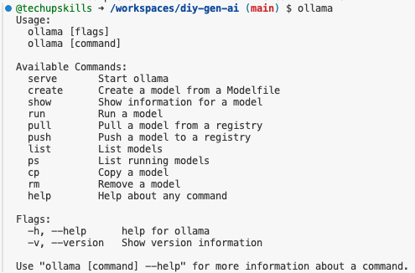
Functions of Ollama
Typically used functions
serve: starts ollama
show: shows info about a specific model
run: allows you to run a previously downloaded model
If model is not present, ollama will download it
pull: downloads a model, without running it once finished
list: prints the list of models available on the machine on the screen
rm: removes the model

Slide 20
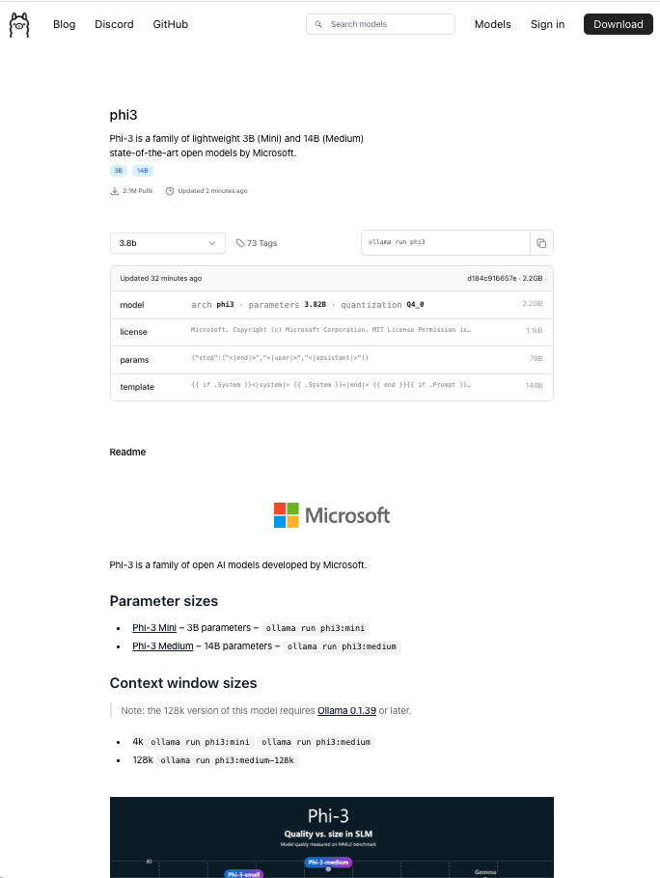
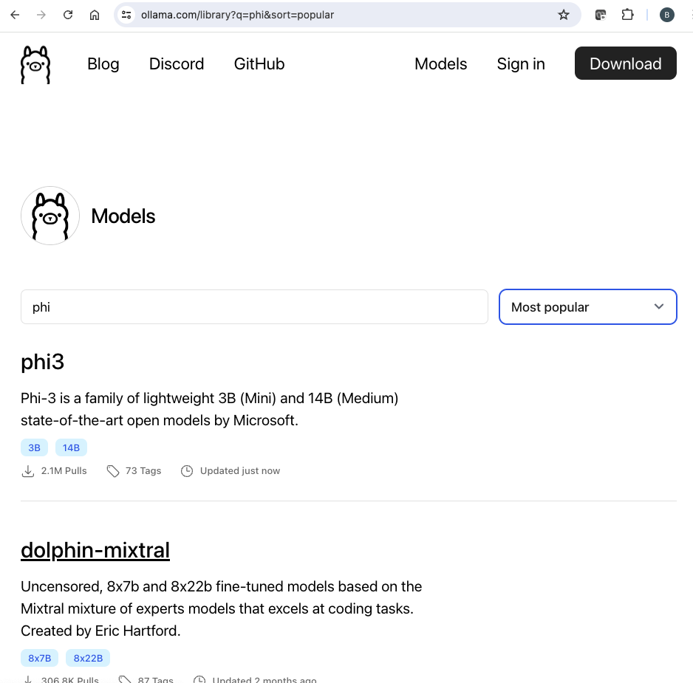
Ollama Models
Not all models are supported
To find supported ones, go to https://ollama.com/library
Click on model link to learn more

Slide 21
Lab 1 Preview: Manual RAG
Step 1: Ask a question about fictional "OmniTech" and observe a generic guess.
Step 2: Open the OmniTech documentation file provided in your environment.
Step 3: Manually copy documentation text into your LLM prompt.
Step 4: Ask the same question and observe the exact, factual response.
Goal: Understand the power of "Augmenting" the prompt with external data.

Slide 22

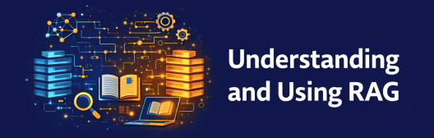
Lab 1 – Grounding data by augmenting prompts
Purpose: In this lab, we’ll see a basic example of augmenting a prompt by retrieving context from a data file

Slide 23
Where We're Headed (Labs 1-6)
Lab 2-3
Lab 6
Vector DBs & Automated Systems
Hybrid RAG: The Final System
Lab 1
Lab 4-5
Manual RAG & Prompt Injection
Knowledge Graphs & Relationships

Slide 24
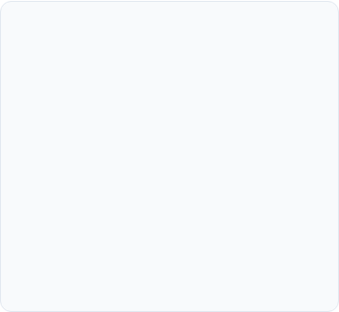
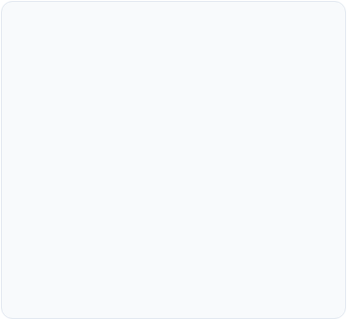
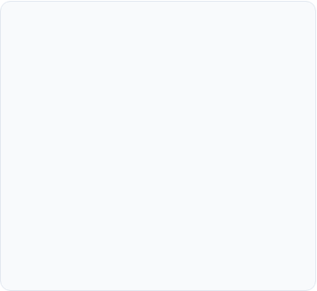



Preparing Your Data
Chunking
Embedding
Indexing
Breaking long documents into small, manageable pieces so the AI can find specific facts easily.
Converting text into numerical vectors (lists of numbers) that represent the mathematical "meaning" of the words.
Storing these vectors in a specialized "Vector Database" for lightning-fast retrieval later on.

Slide 25
Chunking

Slide 26
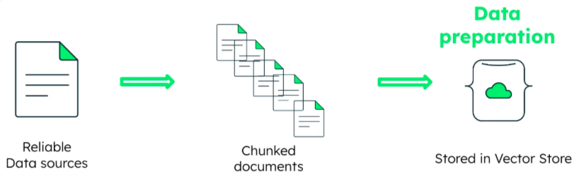
Chunking in RAG
Process of breaking down large documents or pieces of text into smaller, more manageable segments ("chunks")
Generate embedding for each chunk (e.g. OpenAl embeddings, sentence_transformer) using an encoder and store it in a database.
Allows for more efficient search and getting relevant information
Find the Top-K most similar encoded chunks, get the raw text of those chunks, and feed it as context alongside the prompt to the generator.

Slide 27
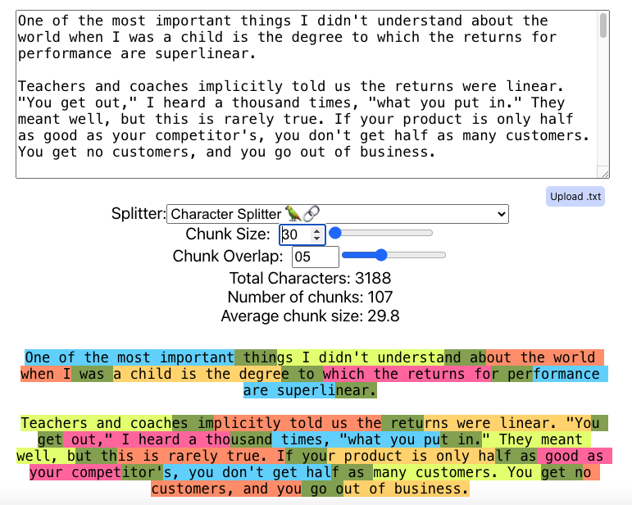
Simple Chunking Strategies for RAG
Fixed size
Works well for content with similar sizes and formats (i.e. articles)
Least requirement for compute
Doesn't consider any context of content
Random chunk size
Useful for dissimilar collection of content (i.e. multiple document types)
May be able to capture more "semantics" w/o depending on structure of any one doc type
Risky because might end up splitting into meaningless chunks
Both use chunk overlap
applies chunking over sliding windows
new chunks overlap content of previous one; contain part of it
allows for better capturing context around edges of chunks and increases semantic relevance overall

Slide 28
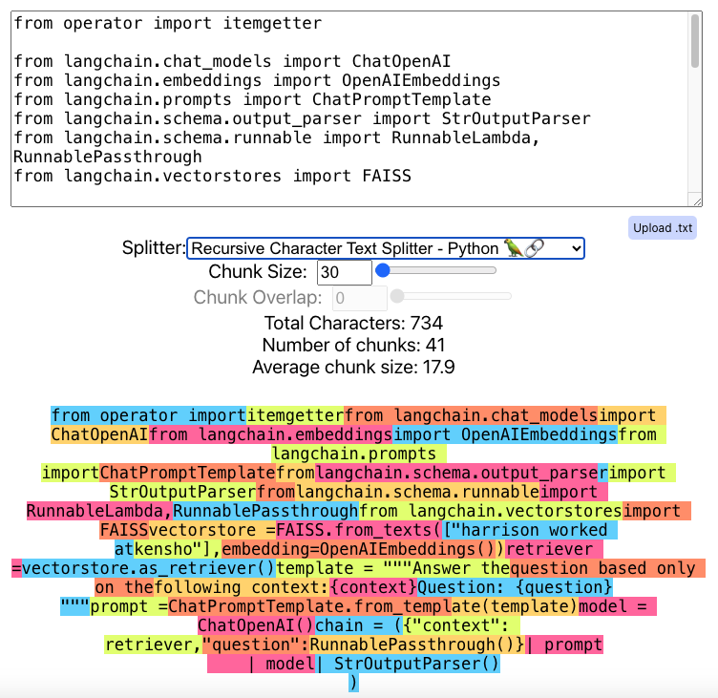
Advanced Chunking Strategies for RAG
Simple methods don't work for some kinds of content
Example: code
Simple methods would result in broken code
Context-aware
Splits docs based on punctuation
Examples: commas, periods, paragraph breaks, markdown tags, HTML tags
Can recursively chunk docs into smaller pieces that overlap
Chapter gets vectorized/linked as well as each page, paragraph and sentence
Requires pre-processing to segment text - can slow down process
Adaptive
Builds on context-aware
Uses machine learning to figure out best size and overlap for any chunk
More complex and more overhead
Produces highly tailored semantic units

Slide 29
Embeddings and Vectors

Slide 30
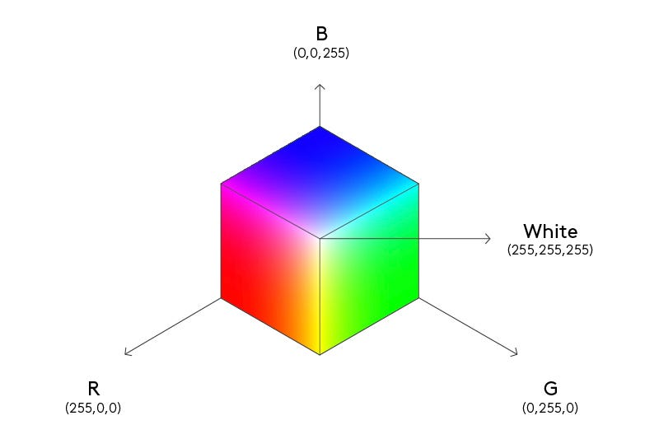
Embeddings
Embeddings represent text as sets of numeric data - tensors (lots of dimensions)
Each dimension stores some info about the text's meaning, context, or syntactical aspects
Words or sentences with similar meanings are stored closer together in the vector space
If two pieces of text are similar syntactically, they will have similar embeddings (smaller distance between their vectors)
During training, models learn to place text with similar meanings closer together in the embedding space
Common pre-trained models used for generating embeddings include BERT and variants (RoBERTa, DistilBERT)
Once you have embeddings, you can use them for NLP tasks like semantic search, text classification, sentiment analysis
Notes:
https://levelup.gitconnected.com/unlocking-llms-potential-with-rag-a-complete-guide-from-basics-to-advanced-techniques-b4557f268134

Slide 31

Semantic meaning / relationships
Suppose we have 3 words
King and Queen are more similar to each other than they are to lunch
In order for neural net to understand the relationships, each word needs to be represented as a vector
Suppose each word is represented by a 2-dimensional vector
King
- 130.16
89.5
Queen
- 115.43
95.2
89.5
34.3
Lunch

Slide 32

Embedding space
2-dimensional space for word embeddings
Plotting in 2-dimensional embedding space shows relationships
Way to let NN understand relationships between words
We want the NN to learn that King and Queen are more similar to each other than they are to lunch
Queen
King
Dimension 2
40 50 60 70 80 90 100
- 130.16
89.5
King
- 115.43
95.2
Queen
Lunch
Lunch
89.5
34.3
-140 -130 -120 -110 -100 -90 -80 Dimension 1

Slide 33
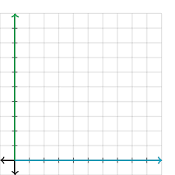
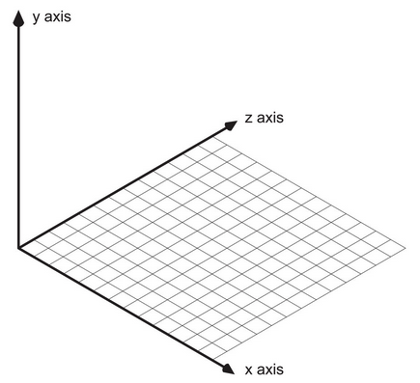
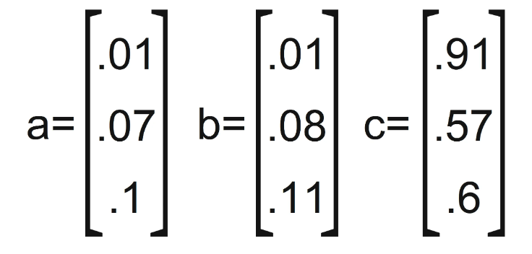
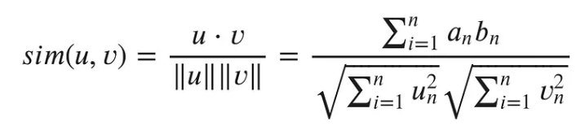
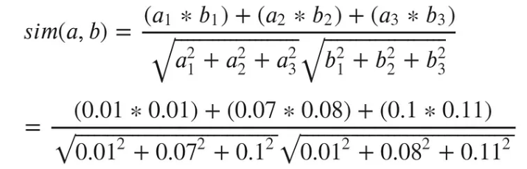
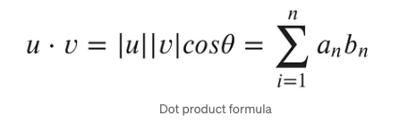
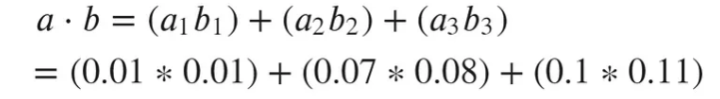
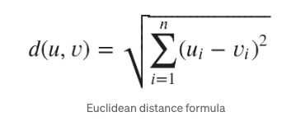
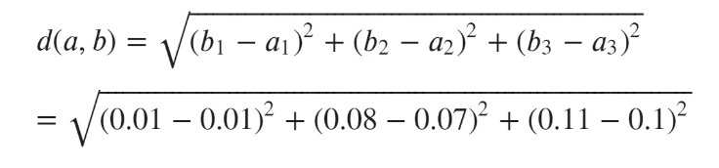
Searching for Vectors - similarity metrics
3 metrics commonly used to determine similarity of two vectors (2-dimensional representation)
imagine 3 vectors - a,b,c
Cosine similarity - measure the angle between two vectors; values from -1 to 1; 1 = both point in same direction; -1 point in opposite directions; 0 = orthogonal (perpendicular)
Cosine similarity
0.0141
Dot product / inner product - measures how well 2 vectors align with each other; values from - ∞ to ∞; positive values indicate vectors are in same direction; negative values indicate opposite directions; 0 = orthogonal
Dot product / inner product
0.0167
Euclidean distance
Euclidean distance - measures the distance between two vectors; values from 0 to ∞; 0 = identical; larger numbers farther apart
0.9998
credit: https://towardsdatascience.com/similarity-metrics-in-nlp-acc0777e234c

Slide 34
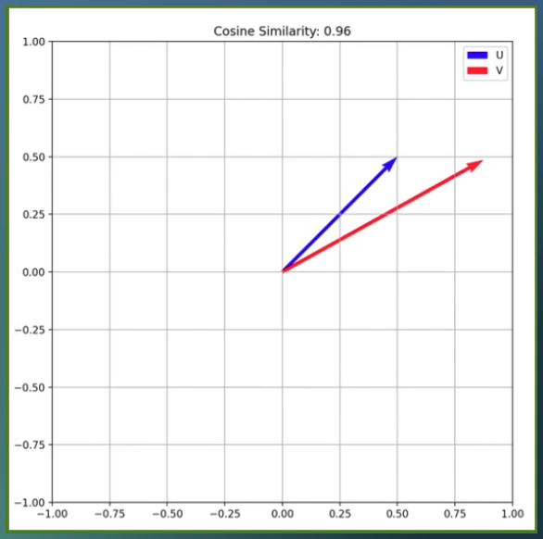
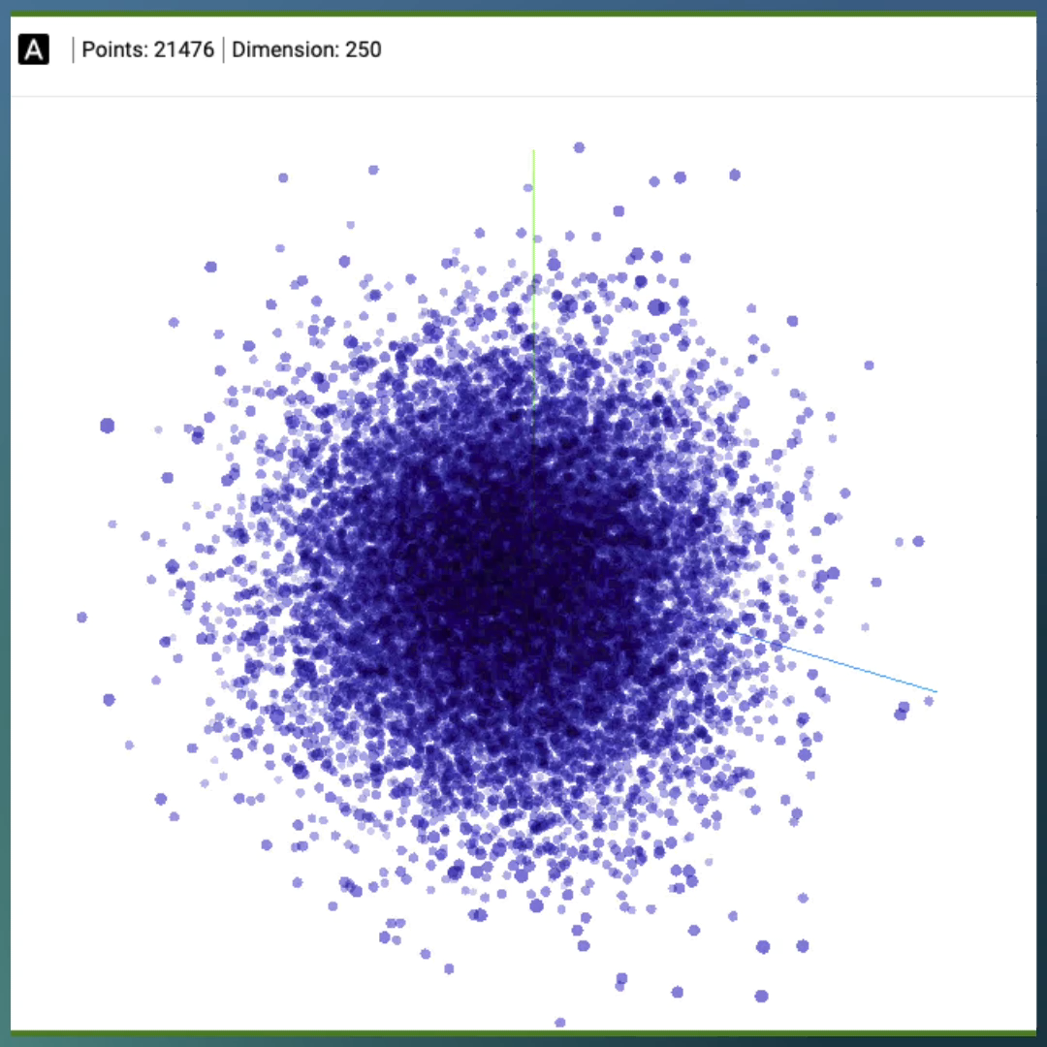
Visualizing Embeddings and Vector Similarity
source: https://projector.tensorflow.org/?config=https://gist.githubusercontent.com/martin-labrecque/4483ff5a104f0b56417585c3bc9a12f1/raw/57348e12a70c8d70c2c573d3dbc0122ac077556b/journaux_config.json

Slide 35
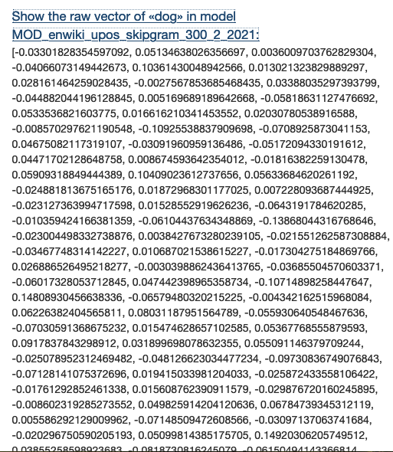
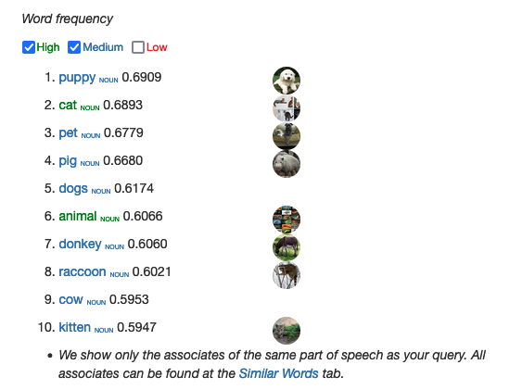
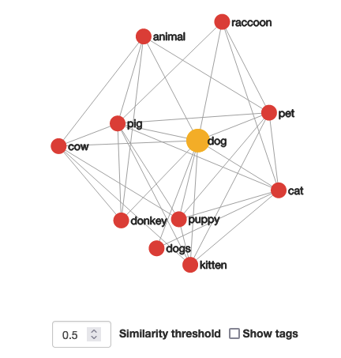
Vectors and relationships example
Query - what words are related to "dog" in model "English Wikipedia"?
Source: http://vectors.nlpl.eu/explore/embeddings/en/MOD_enwiki_upos_skipgram_300_2_2021/dog_NOUN/

Slide 36
Vector Databases

Slide 37
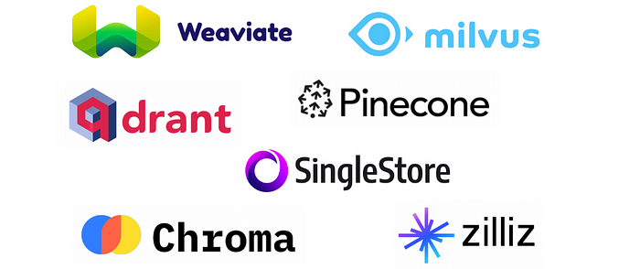
Vector Databases
Specialized database that index and stores vector embeddings
Useful for
fast retrieval
similarity search
Offer comprehensive data management capabilities
metadata storage
filtering
dynamic querying based on associate metadata
Scalable and can handle large volumes of vector data
Support real-time updates
Play key role in AI and ML applications
Vector Database
Vector Database
Vector Database

Slide 38
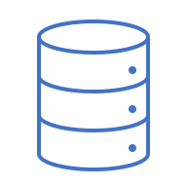

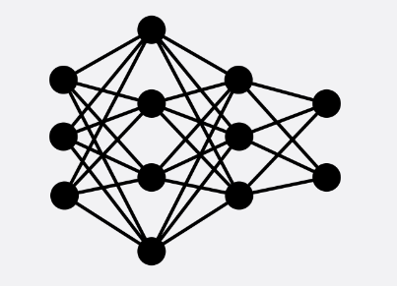


How data gets into Vector Databases
Data is input, converted to embeddings (vectors) and stored
Queries are input, converted to embeddings (vectors) and then similarity metrics are used to find results ("nearest neighbors")
embedding models
0.1, 1.2, ..., ..., - 0.5, 3.17
Vector Database
-0.57, 1.0, ..., ..., 2.15,1.1
Documents
NLP Transformer
2.1, 0.12, ..., ..., -1.50, 0.3
1.1, 0.74, ..., ..., - 0.2, 1.7
0.6, -0.71, ..., ..., 0.35, -1.2
Images
Image Transformer
1.1, -2.15, ..., ..., 2.1, 0.35
0.4, 0.36, ..., ..., -0.7, -2.45
Audio
Audio Transformer

Slide 39

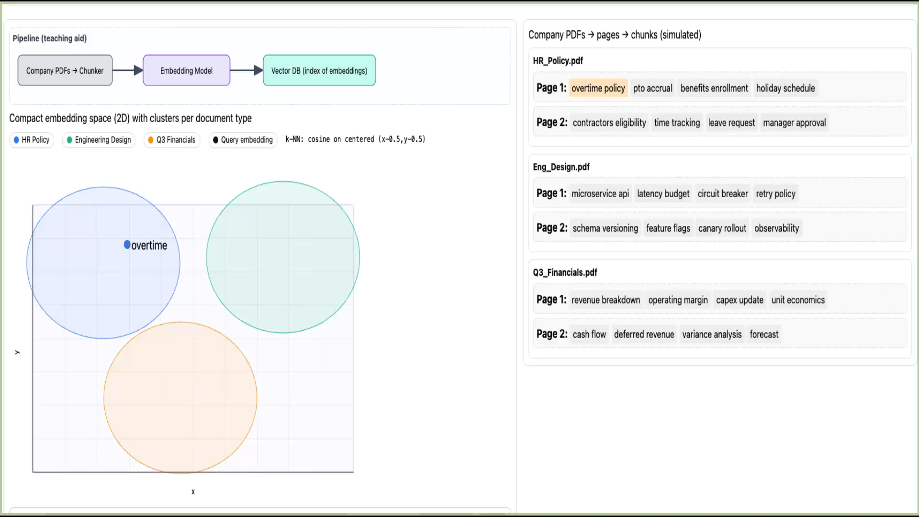


RAG prep – parsing your data and storing as relationships

Slide 40
Our Prompts also becomes Vectors
Input: 'How do I reset my password?'
↓
Model: Sentence Transformer (all-MiniLM-L6-v2)
↓
Output: [0.12, -0.34, 0.56, ...] (384-dim vector)
The Model:
Fast and efficient
Trained on millions of sentence pairs

Slide 41
Lab 2 – Working with Vector Databases
Purpose: In this lab, we’ll learn how to use vector databases for storing data and doing similarity searches

Slide 42
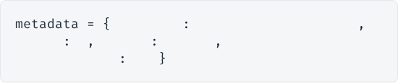
Enriching with Metadata
Why Metadata Matters?
Every chunk stores context about where it came from.
➜
Citations: Tell the user exactly which page the answer came from.
"source"
"Returns_Policy.pdf"
➜
Filtering: "Search only in 'text' chunks" or "Search only this file".
"page"
5
"type"
"text"
# or "table"
"chunk_index"
12
➜
Debugging: Trace bad answers back to source.

Slide 43
Indexing: Metadata
PDF
Code
Each chunk stores:
- Source filename
- Page number
- Content type (text vs table)
- Chunk index
Usage:
- Source attribution
- Citations
- Filtering
Metadata stored:
file_path
language
start_line
end_line
Enables precise linking:
Found in: src/auth/login.py:42-68

Slide 44
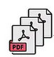

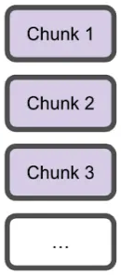
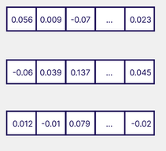





Detailed Data Ingestion Pipeline (Vector DB)
Split into chunks
Embeddings as vectors
Embeddings stored into semantic index
Extract data
Chunks of text
Embedding API
Knowledge base
Build semantic index
conversion
Stores embeddings / chunks
ChromaDb, Pinecone, Azure Index, Neo4j, etc. AKA "vector store"

Slide 45





Common PDF Parsing Frameworks
Tool / Framework | What it does (for RAG over PDFs)
Unstructured.io | Open-source, layout-aware PDF -> clean text/elements
LlamaParse | Hosted, high-fidelity PDF -> Markdown/text for complex layouts
Docling | OSS, high-quality parsing for complex, layout-heavy PDFs
Marker | PDF -> Markdown with OCR, good for long-form text
PageMage | Research-grade parser for scientific PDFs with structure
pypdf / PyPDF2 | Simple Python PDF text extraction for basic docs
pdfplumber | Text + coordinates and table extraction
LangChain | RAG framework with multiple PDF loaders and chunkers
LlamaIndex | RAG framework with nod—based PDF ingest and chunking
Nanonets/Firecrawl | Managed APIs that output RAG-ready chunks from PDFs

Slide 46
Key Takeaways
1. Vectors represent meaning (Semantic Search)
2. Vector Databases allow fast similarity lookup
3. Chunking strategy is critical (Text vs Code)
4. Metadata allows for precise citation
5. Quality Retrieval = Quality Generation (RAG)

Slide 47


Using prompt templates to incorporate retrieved chunks
A scaffold or blueprint that guides the AI in generating a response. It usually contains placeholders or variables that can be dynamically filled based on specific input data
Optimizing prompt templates is a crucial technique for improving the performance of AI models
A well-designed prompt template not only provides clear instructions to the model but also structures the interaction in a way that the model can best utilize its training
Prompt templates can direct the model in how to factor in (or not) retrieved data
Only use retrieved data
Augment LLMs query with retrieved data

Slide 48
Putting It All Together: The RAG Flow
1. INDEX PHASE (One time)
- Extract -> Chunk -> Embed -> Store
2. SEARCH PHASE (Every query)
- Query -> Embed -> Retrieve
3. GENERATION PHASE (RAG)
- Retrieved Chunks + Prompt -> LLM -> Answer

Slide 49



RAG – Retrieval Augmented Generation
Query: overtime policy for contractors
AI Response: Here's some information on our overtime policy for contractors and how overtime works…
Augmented Prompt
LLM

Slide 50
Lab 3 – Working with RAG implemented with vector dbs
Purpose: In this lab, we’ll build on the use of vector databases to parse a PDF and allow us to include it in context for LLM queries

Slide 51





Typical RAG Pipeline (Vector DB)
Split into chunks
Embeddings as vectors
Embeddings stored into semantic index
Extract data
Chunks of text
Embedding API
Build semantic index
conversion
Knowledge base
Query
Embedding API
Takes in the embeddings
Stores embeddings / chunks
Embedding
Semantic search
User
Compares with the embeddings in vector store
ChromaDb, Pinecone, Azure Index, Neo4j, etc. AKA "vector store"
These become context for the LLM
extracts # of similar results you want (top K)
Answer
Large Language Model (LLM)
Ranked results

Slide 52
Knowledge Graphs

Slide 53
What is a Knowledge Graph?
Structure to represents info in relational, interconnected format
entities = nodes, relationships = edges
Can find new information by exploring relationships
Query #1: Where does Sue work?
Answer #1: Sue works at Acme
Question #2: Who works for Acme?
Answer #2: Joe and Sue work for Acme.
Question #3: Does Sue work for the same company as Joe?
Answer #3: Yes, Sue works for the same company as Joe.
Type: Employer
Name: Acme
works at
works at
Type: Employee
Name: Joe
Type: Employee
Name: Sue

Slide 54
Knowledge Graph Challenges
Construction - need to identify and extract relationships, entities from data sources and integrate them into a graph
Data consistency and compatibility - data can come from multiple sources; needs to be made consistent, have conflicts resolved, cleaning etc.
Maintenance and evolution - graphs need to be continuously updated and maintained
Performance and scalability - growth in size and complexity can be difficult to manage; optimization becomes critical
Complexity of queries - crafting complex queries can be challenging
No standardization - lack of compatibility and lock-in to app/vendor
Explainability - for users
Domain complexity - terminology, complex concepts, etc.

Slide 55
Graph RAG

Slide 56

Graph RAG in AI
RAG that incorporates knowledge graphs or graph databases
AI retrieves information not just from unstructured text docs but from structured graph data
Allows model to leverage rich relationships and entities encoded within graphs
Image credit: https://medium.com/@nebulagraph/graph-rag-the-new-llm-stack-with-knowledge-graphs-e1e902c504ed

Slide 57



Key Components of Graph RAG
Graph-based knowledge: Information is stored as entities (nodes) and their relationships (edges).
Graph retrieval: Queries fetch relevant nodes or subgraphs related to the question.
Augmented generation: The retrieved graph data is used by the language model to produce better answers.

Slide 58

Benefits of using Knowledge Graphs in RAG
Structured knowledge
Information is stored as entities and relationships (nodes and edges).
Example: A “works at” relationship shows who works for Acme.
Better context
Relationships help the system understand how things are connected.
Example: Knowing Sue and Joe both “work at” Acme helps answer employment questions.
Inferential reasoning
Following relationships allows the system to infer new facts.
Example: The system can infer Sue and Joe work for the same company.
Knowledge integration
Graphs can combine data from multiple sources into one view.
Example: Adding data about other companies and employees enriches answers.
Transparency and explainability
The graph makes it easier to explain how an answer was derived.
Example: “Sue and Joe both have a ‘works at’ relationship with Acme.”

Slide 59
Applications of Graph RAG
Question Answering Systems: Providing precise answers by querying knowledge graphs for specific facts or relationships.
Dialogue Systems: Enhancing conversational agents with context-aware responses based on user history or preferences stored in graphs.
Recommendation Systems: Generating personalized recommendations by traversing user-item interaction graphs.
Example Workflow for Graph RAG
User Input: A user asks, "What movies directed by Christopher Nolan feature time travel?"
Graph Retrieval: The system queries a movie knowledge graph to find nodes connected to "Christopher Nolan" with relationships indicating "directed" and retrieves movies associated with "time travel."
Generation: Using the retrieved information, the model generates a response: "Christopher Nolan directed 'Interstellar,' which features themes of time travel."

Slide 60
Neo4j

Slide 61


What is Neo4j?
Graph database
Neo4j stores data as nodes (entities) and relationships.
Cypher query language
Uses Cypher, a SQL-like language designed for graph queries and traversals.
Fast for connected data
Optimized for exploring relationships, paths, and complex connections.
Scalable and reliable
Supports clustering and scaling for large datasets and high availability.
Common use cases
Fraud detection, recommendations, social networks, and knowledge graphs.

Slide 62


Cypher
Neo4j's graph query language (like SQL for graphs)
Provides a way of matching patterns and relationships
graph model is made of nodes and relationships
nodes and relationships together make up "patterns"
Cypher is designed to recognize versions of patterns in data
can do simple or complex path traversals
Has its own open source implementation (openCypher)
Basic of graph query language (GQL) standard
Image credit: https://neo4j.com/product/cypher-graph-query-language/

Slide 63


Cypher vs SQL
Similarities
Example - both use WHERE & ORDER BY
More schema flexibility in Cypher
Cypher doesn't require a fixed schema
New attributes and relationships can be added as graphs evolve
Cypher has different order for query
Returns values after finding relationships vs selecting values
Cypher queries are more concise

Slide 64
Lab 4 – Implementing Graph RAG with Neo4j
Purpose: In this lab, we’ll we’ll see how to implement Graph RAG by querying a Neo4j database and using Ollama to generate responses

Slide 65
Frameworks for use with RAG

Slide 66

What are frameworks and why do we use them?
What they are
Tools that help build AI apps using LLMs plus external data (documents, databases, APIs).
Why use them
Easy integration
Connect LLMs to data sources with minimal setup.
Flexible pipelines
Build modular retrieval and generation workflows.
Efficient retrieval
Use built-in vector search and indexing for better results.
Smarter queries
Combine retrieval and reasoning for more accurate answers.
Faster development
Reuse pre-built components instead of building everything from scratch.

Slide 67




Framework selection
Data support
Handles your document, structured, or graph data
Retrieval options
Vector, graph, keyword, or hybrid search
Model flexibility
Supports cloud and local LLMs
Ingestion & storage
Indexing, metadata, and database integration
Quality & control
Evaluation, observability, and security
Scalability & usability
Performance, reliability, and developer experience

Slide 68

LangChain
Overview
LangChain is a comprehensive framework designed to facilitate the development of applications that integrate LLMs with other data sources or external tools. It enables chaining different steps together to build complex pipelines for LLMs, including retrieval tasks, multi-step conversations, and more.
Summary
Ideal for complex, multi-step pipelines with diverse integrations
Advantages:
Modular (chain together) with broad integrations
Broader ecosystem integrations with APIs, LLMs, other external sources
Pre-built workflows
Support for tools
Disadvantages:
More complex to learn and setup
Heavier for basic tasks; more overhead for simple tasks
Use Cases:
Complex RAG applications with multi-step operations and diverse data sources
API/data integrations
Advanced conversational agents and knowledge retrieval systems
Fit for RAG
LangChain shines in more complex RAG scenarios where you need to combine document retrieval with multiple other steps or when pulling in data from diverse sources (e.g., APIs, tools).
Notes:
Overview:
LangChain is a comprehensive framework designed to facilitate the development of applications that integrate LLMs with other data sources or external tools. It enables chaining different steps together to build complex pipelines for LLMs, including retrieval tasks, multi-step conversations, and more.
Advantages:
Modularity: LangChain offers a highly modular structure, allowing developers to chain together various steps such as retrieval, transformation, and generation, facilitating complex workflows.
Broader Ecosystem: It integrates with a wider variety of external sources, APIs, and LLMs, making it more versatile in building complex applications.
Pre-built Pipelines: Comes with various pre-built components and templates, which makes it easier to rapidly build LLM-powered apps.
Support for Tools: LangChain can integrate with databases, APIs, knowledge graphs, and other tools beyond just document retrieval.
Disadvantages:
More Complex: Its broad functionality makes it slightly more complex to learn and set up for simpler tasks compared to LlamaIndex.
Heavier: LangChain may introduce some overhead in cases where simple document retrieval and response generation would suffice.
Use Cases:
Complex RAG pipelines where multi-step operations are required (e.g., fetching documents, summarizing, re-ranking results, then generating an answer).
Applications needing multi-modal or multi-step integration, such as chatbots that can look up data from APIs or interact with databases.
Advanced conversational agents and knowledge retrieval systems.

Slide 69



GraphCypherQAChain
What it is
A LangChain component that connects natural language to graph databases (like Neo4j).
How it works
Ask a question in plain language
An LLM converts it into a Cypher query
The query runs on the graph database
Results are returned as a readable answer
Why it’s useful
No need to learn Cypher
Easier access to graph data
Faster application development
Common use cases
Interactive data exploration
Chatbots and virtual assistants
Educational and learning tools
Query

Slide 70
Lab 5 – Simplifying Graph RAG with Frameworks
Purpose: In this lab, we’ll see how to simplify Graph RAG by leveraging frameworks and using LLMs to generate queries

Slide 71



Slide 72

Implementing RAG - Data Stores
Data stores (databases) for RAG are primarily either:
Vector databases
Graph databases
Hybrid

Slide 73
Hybrid RAG
Semantic + Knowledge Graph
Combining Meaning and Structure for Complete Retrieval

Slide 74

Meaning vs Structure
Semantic Search
Understands MEANING: Handles natural language flexibility and vocabulary mismatches (e.g., "money back" → "refund").
Uses ChromaDB with vector embeddings to find conceptually related content.
Graph Search
Understands STRUCTURE: Maps explicit relationships between entities (e.g., Pro_Series → HAS_TIMEFRAME → 14_Days).
Uses Neo4j with Cypher queries for precision facts.

Slide 75


The OmniTech Knowledge Graph
A pre-built graph in Neo4j extracted from OmniTech PDFs:
36 Nodes & 48 Relationships
Key Entities: Products, Policies, Contacts, TimeFrames, Conditions.
Relationships: APPLIES_TO, HAS_TIMEFRAME, HANDLES.
This allows the agent to traverse facts like a map rather than just searching for text chunks.

Slide 76

From Documents to Knowledge Graph
Approach | How it Works
Manual | Human identifies entities and relationships, structures into CSV/Cypher.
NER | NLP models identify entities (names, dates, orgs) automatically.
LLM | Prompting an LLM to "Extract entities and relationships" from text.

Slide 77




Same Query, Different Results
Query: "What's the return window for Pro-Series equipment?"
SEMANTIC (ChromaDB)
GRAPH (Neo4j Cypher)
Finds text chunks where "return window" and "Pro-Series" appear.
Traverses explicit edges to return the specific node value.
Returns the direct fact: 14 days.
Requires LLM to parse and extract the answer.

Slide 78


Traversing Relationships
Graphs shine when connecting distant facts. Consider the query: "Who do I contact about a defective item?"
The graph followed the path: DOA_Policy ← HANDLES ← Tech_Support

Slide 79
Why Combine Both?
Approach | Tool | Strength | Weakness
Semantic | ChromaDB | Natural language, context, synonyms | May miss precise structural data
Graph | Neo4j | Precise facts, relationship traversal | Only as good as the modeled data
Hybrid | Both | Complete, precise, contextual answers | Slightly more complex architecture
Hybrid Scenario: Use Graph for the 14-day window fact, and Semantic for the paragraph explaining exceptions.

Slide 80

The Hybrid RAG Architecture
Query: The question is sent to both databases.
Retrieval: Graph returns precise facts; Vector DB returns contextual chunks.
Augment: The LLM prompt is built using the union of both datasets.
Generate: Ollama synthesizes the final coherent answer.

Slide 81

Hybrid RAG: Key Takeaways
ChromaDB understands MEANING. It handles natural language flexibility and synonyms.
Neo4j understands STRUCTURE. It handles precise facts and explicit connections.
Together they provide COMPLETE answers. The LLM synthesizes facts and context for high-quality generation.
Strategy: Use Graph for facts/contacts and Semantic for explanations/exceptions.
Precision + Context = Production Grade RAG

Slide 82
Lab 6 Code Structure
Initialize Connections: Set up both ChromaDB PersistentClient and Neo4j Graph connection in the HybridRAG class.
Semantic Search: Execute collection.query() to retrieve context from vector embeddings.
Graph Search: Execute graph.run() with Cypher to retrieve structured relationship data.
Hybrid Integration: Merge graph_results and semantic_results to augment the LLM prompt.

Slide 83
Lab 6 – Hybrid RAG: Semantic Search + Knowledge Graph
Purpose: In this lab, we'll build a hybrid RAG system that combines semantic search (ChromaDB) with knowledge graph traversal (Neo4j) to get both precision and context in our answers.

Slide 84


Slide 85
Choosing Your RAG Strategy
Use Case | Best Approach
Natural language Q&A | Semantic (ChromaDB)
Precise facts (dates, contacts) | Graph (Neo4j)
Relationship questions ("Who handles X?") | Graph (Neo4j)
Vocabulary mismatch ("money back" → refund) | Semantic (ChromaDB)

Slide 86




That’s all - thanks!
Contact: training@getskillsnow.com
techskillstransformations.com
getskillsnow.com

Slide 87

Tip: Persisting your codespace
When signed in, go to github.com/codespaces
Find codespace at bottom
Click on "..."
Select "Export changes to a branch"
Will make a fork of original repo and put your changes into a new branch

